Slide 1
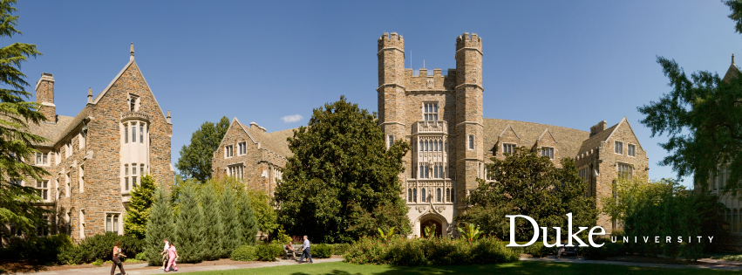
CEI summer internship
Jingyang Zhang
04/28

Slide 2
Overview
Federated Learning
Jingwei
NAS
Tunhou
OOD detection
Jingyang, Randy, (Matt)
Just to go through projects for OOD detection on my side
Feel free to reach out to other students
Think carefully before you start on any project

Slide 3



OOD detection
Suppose we have a classifier that knows about animals
When inputs are animals: accurate classification, nice
What if the inputs are not animals?
Open world
In-distribution (ID) samples
Out-of-distribution (OOD) samples
OOD detection is crucial for reliable/trustworthy operation!
Without OOD detector
dog
Classifier
bird
dog?bird?
With OOD detector
dog
Classifier
OOD detector
bird
I don’t know!

Slide 4
Topic 1: Ensemble for better OOD-accuracy trade-off
Inspired by adversarial robustness research and DVERGE
Non-robust features are easier to learn and generalize, but cause adversarial vulnerability
Using an ensemble to learn diverse non-robust features to gain robustness without hurting clean accuracy
Outlier exposure hurts ID accuracy
This is because the removal of spurious features
Spurious features: Useful but not truly correlated with the ID semantics, so they can be activated by OOD samples
Similarly, we can use ensemble to learn diverse spurious features to mitigate ID accuracy loss
baseline
OOD performance
OE
Ensemble-OE
Acc

Slide 5

Topic 1: Ensemble for better OOD-accuracy trade-off
ID
DNN-1
dog
car
ship
fruit
dog
car
ship
fruit
…
OOD
DNN-n
dog
car
ship
fruit
dog
car
ship
fruit
dog
car
ship
fruit
dog
car
ship
fruit

Slide 6
Topic 1’s plan
Literature review on ensemble-based OOD detection methods
Implement this idea
Evaluation on multiple datasets
…
Output goal
Second-tier conference/workshop if stick to this idea
Everything is possible if you add new components/ideas

Slide 7
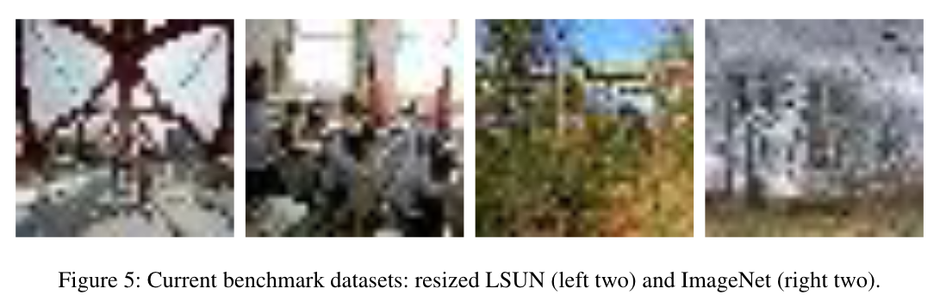
Topic 2: A comprehensive evaluation/benchmarking idea
Since the seminal work in 2017, there are probably several tens of papers on OOD detection in top-ML conferences (ICLR, CVPR, ICML, ECCV/ICCV, NeurIPS, AAAI)
Despite the efforts, the progress is hard to track because:
Some popular/common benchmarks have significant shortcomings without being sufficiently recognized (still people continue to use them)
Many papers use (partially) different or their own proposed benchmarks (double-check)
There are no standard setup for training details (e.g., architecture, training budget, lr schedule, augmentation, etc.), which can affect a lot (double-check) (as an example, the adversarial robustness community does have standards on this)
Towards detecting semantic anomalies (semantic / non-semantic)
In practice, the images within a stable operational environment may have little non-semantic variations (have citation on this)
Also, ultimately/ideally we want models to recognize semantics
Are we really making progress on this? (also the relationship with Open-set Recognition)

Slide 8
Topic 2: A comprehensive evaluation/benchmarking idea
Therefore, a work that comprehensively evaluates existing works using a unified benchmark/training setup/etc. is necessary to review/track recent progress
Also helps identify challenges and opportunities
Anticipated datasets
ID: CIFAR-10, TinyImageNet, ImageNet, fine-grained
OOD: non-semantic (used by current papers); semantic (e.g., CIFAR-10 v.s. CIFAR-100)
Can also explore the effect of architecture/training setup
Provide our findings and recommend a setup for future works to follow for benchmarking purposes
Notes:
Transformers? CNNs?

Slide 9
Topic 2’s plan
Create a chronological list of OOD detection/open-set recognition papers in ML top-tier conferences (2017-2022)
Reproduce/implement all these methods
Evaluate them in a controlled environment
…
Output goal
Top-tier conference (e.g., ICLR)

Slide 10
My involvement
I have my own internship, but should be available most times
I’m happy to discuss anything
Code details, experiments, new ideas…
Authorship
I will take the lead when writing the paper
Equal contribution

